Slide 1
Don't Write Secure Code! (Build secure systems instead)
Seth Petry-Johnson @spetryjohnson

Slide 2
I hate writing secure code

Slide 3
I hate writing secure code I hate writing secure feature code

Slide 4
I hate writing secure code I hate writing secure features I hate implementing cross-cutting security concerns by repeating the same patterns over and over again in my feature-level code

Slide 5
What's on the agenda?
Define "cross cutting" security concerns

Slide 6
What's on the agenda?
Define "cross cutting" security concerns
"Secure by default" examples

Slide 7
What's on the agenda?
Define "cross cutting" security concerns
"Secure by default" examples
Declarative vs Imperative security

Slide 8
What's on the agenda?
Define "cross cutting" security concerns
"Secure by default" examples
Declarative vs Imperative security
Audit / Testing

Slide 9
Application "framework"
Any code that leverages "hooks"
in the underlying system

Slide 10
What framework stuff can I tap into?
MVC ActionFilter attributes (OnActionExecuting)
jQuery AJAX events (ajaxStart, ajaxEnd, ajaxPrefilter)
ORM interceptors (connection opened)
PostSharp (property access, method boundaries)

Slide 11
"Cross cutting" concern
Any security requirement that
spans multiple features

Slide 12

"Cross cutting" concerns
Security Requirements:
User must be logged in
Users with the "Manage Orders" permission see all Orders
Everyone else sees only their own Orders

Slide 13
"Cross cutting" concerns
Security Requirements:
User must be logged in
Users with the "Manage Orders" permission see all Orders
Everyone else sees only their own Orders

Slide 14
"Cross cutting" concerns

Slide 15
"Cross cutting" concerns

Slide 16
"Cross cutting" concerns

Slide 17
"Cross cutting" concerns

Slide 18
"Cross cutting" concerns

Slide 19
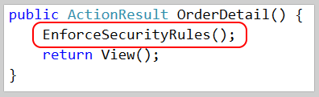
"Cross cutting" concerns

Slide 20
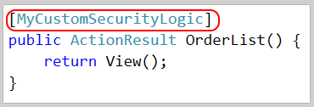
"Cross cutting" concerns

Slide 21

"Cross cutting" concerns

Slide 22
Show me the codez! bit.ly/2i0J91d

Slide 23
SQL Injection Little Bobby Tables, at it again

Slide 24
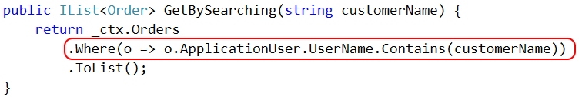

SQL Injection

Slide 25
Cross Site Request Forgery Fun fact*: users never log out. Ever.
* Not actually a fact.

Slide 26
Cross Site Request Forgery (CSRF)

Slide 27
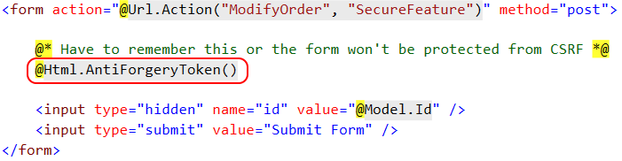
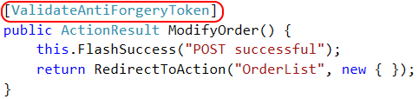
CSRF Defense – feature

Slide 28

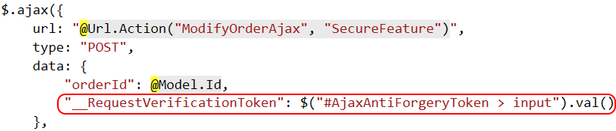
CSRF Defense – feature (ajax)

Slide 29
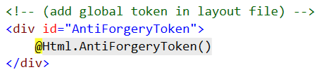
CSRF Defense – cross cutting

Slide 30
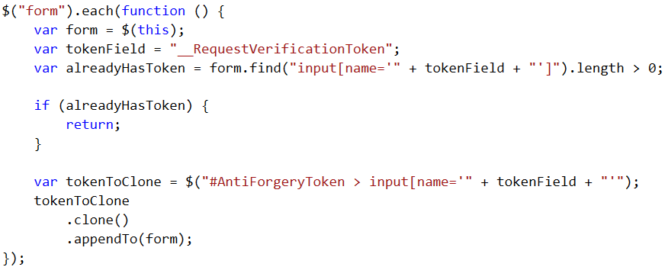
CSRF Defense – cross cutting

Slide 31
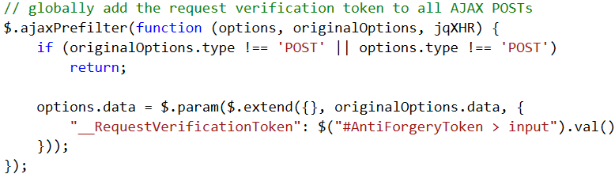
CSRF Defense – cross cutting

Slide 32
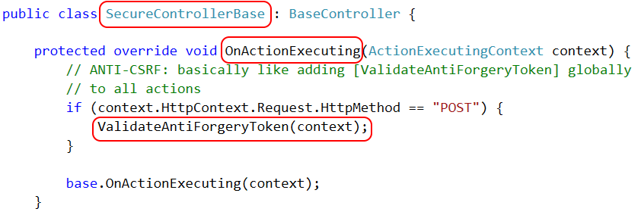
CSRF Defense – cross cutting

Slide 33

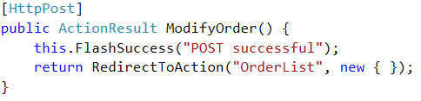
CSRF Defense – cross cutting

Slide 34
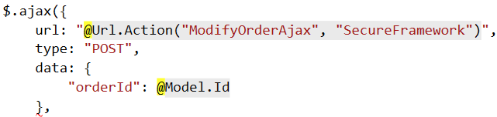
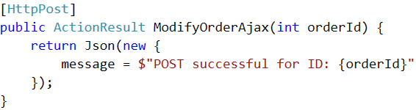
CSRF Defense – cross cutting (ajax)

Slide 35
Authentication Keeping out the unwashed masses

Slide 36
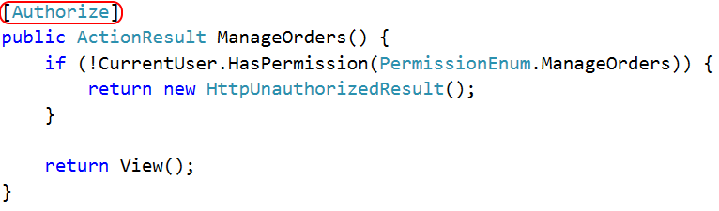
Authentication

Slide 37
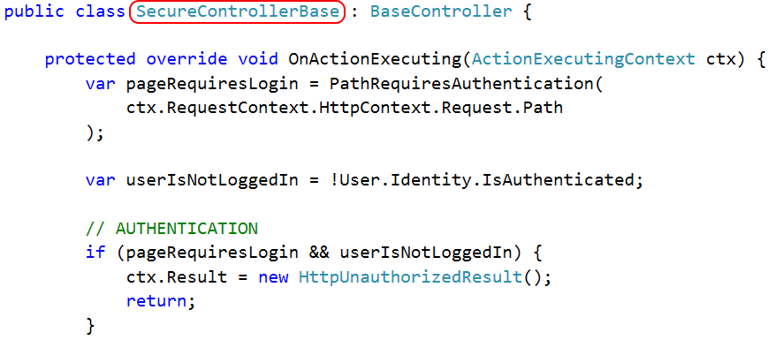
Authentication

Slide 38
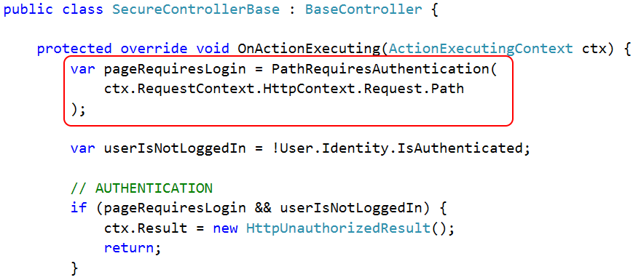
Authentication

Slide 39
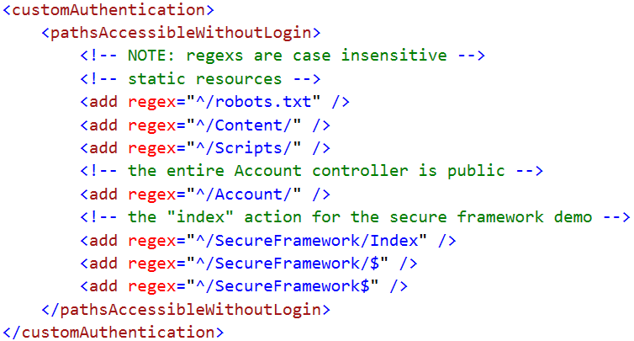
Authentication

Slide 40
Authentication

Slide 41
Access Control Keeping Bob's hands off Alice's data

Slide 42
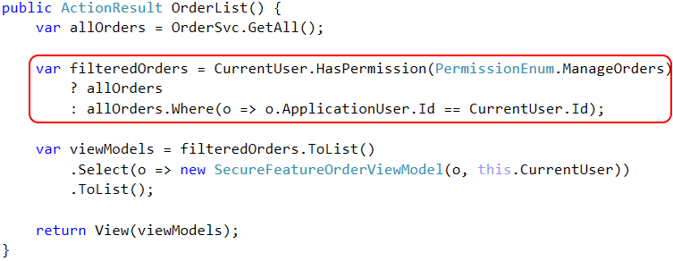
Access Control – feature

Slide 43
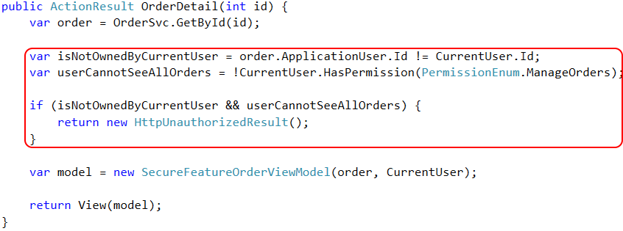
Access Control – feature

Slide 44
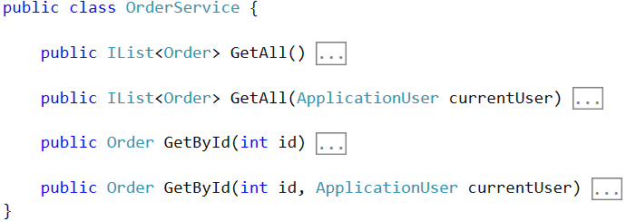
Access Control – framework

Slide 45
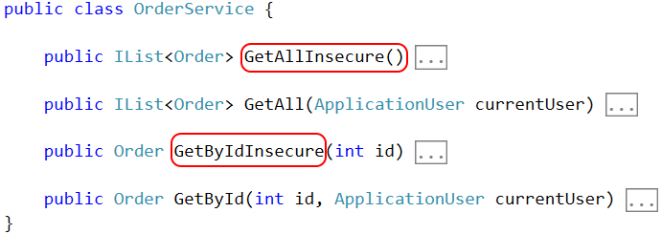
Access Control – framework

Slide 46
Access Control – Row Level Security

Slide 47
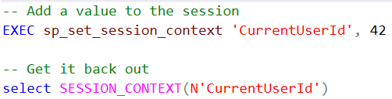

Access Control – Row Level Security

Slide 48
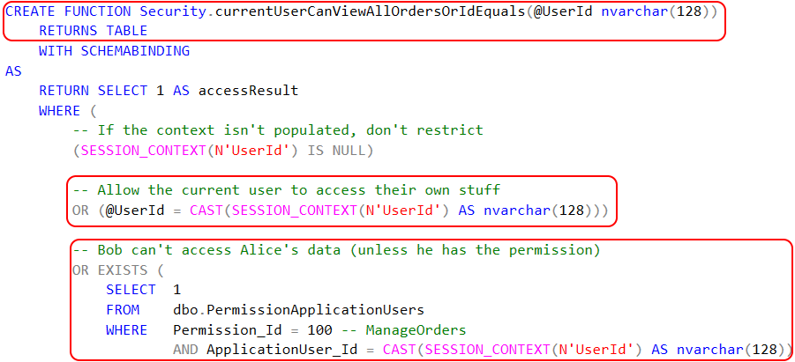
Access Control – Row Level Security

Slide 49

Access Control – Row Level Security

Slide 50
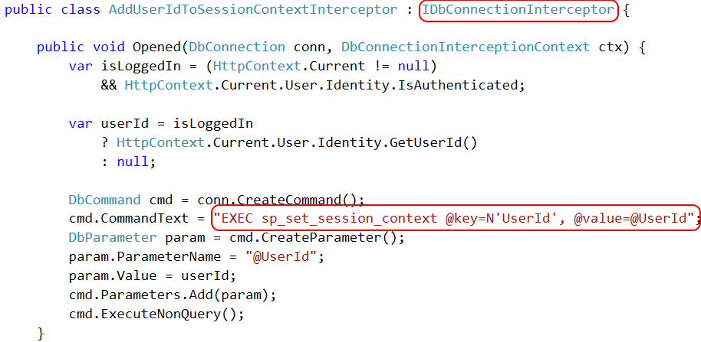
Access Control – Row Level Security

Slide 51
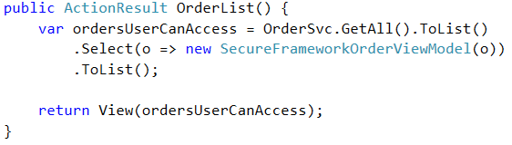
Access Control – framework

Slide 52
Page-level Authorization Keeping Bob in his sandbox

Slide 53
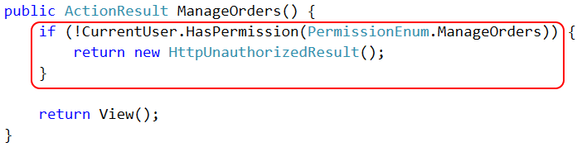
Page Authorization – feature

Slide 54
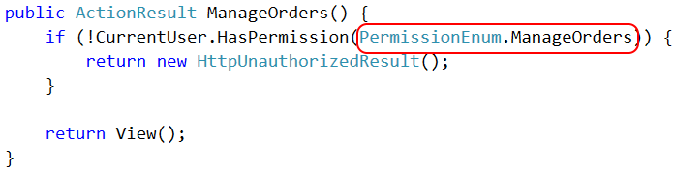
Page Authorization – feature

Slide 55

Page Authorization – cross cutting

Slide 56
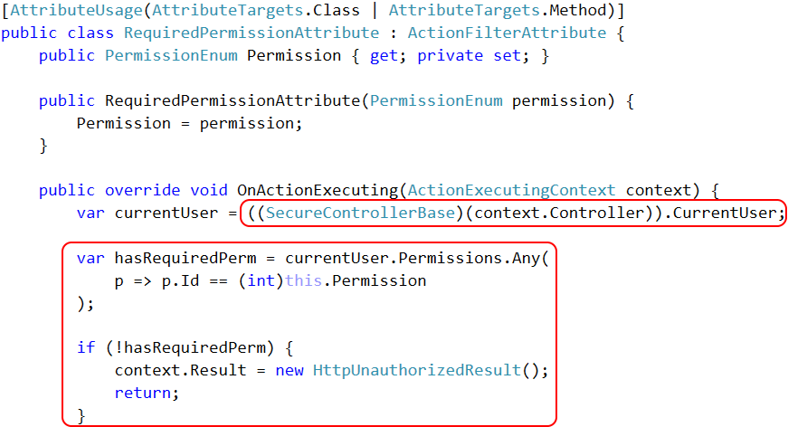

Slide 57
Property-level Authorization Keeping private data private!

Slide 58
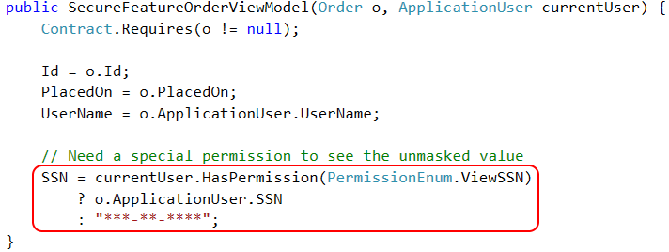
Property Authorization – feature

Slide 59
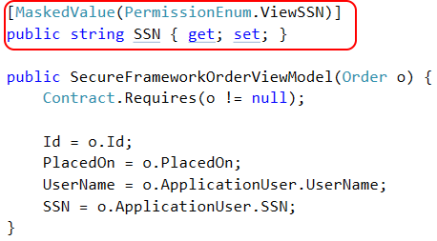
Property Authorization – cross cutting

Slide 60
Property Authorization – cross cutting

Slide 61
Property Authorization – cross cutting

Slide 62
Property Authorization – cross cutting

Slide 63
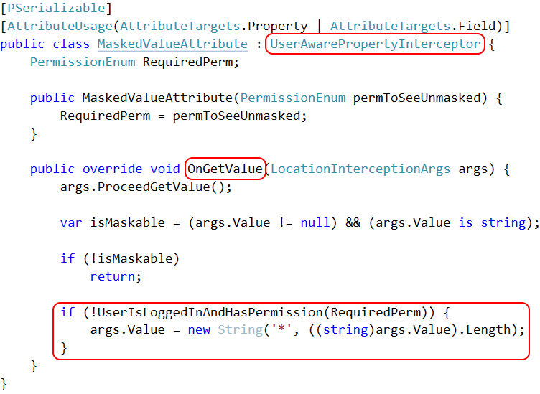

Slide 64
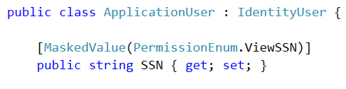
Property Authorization – cross cutting

Slide 65

Property Encryption – cross cutting

Slide 66
Auditing and Testing Try this with your fancy dynamic language!

Slide 67
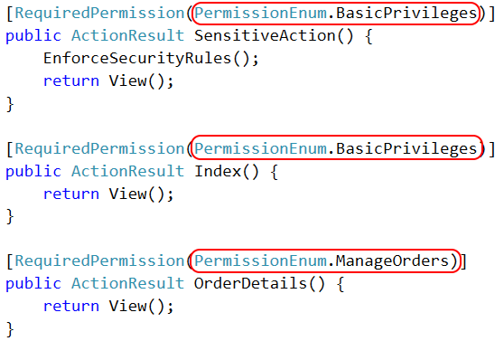
Authorization auditing

Slide 68
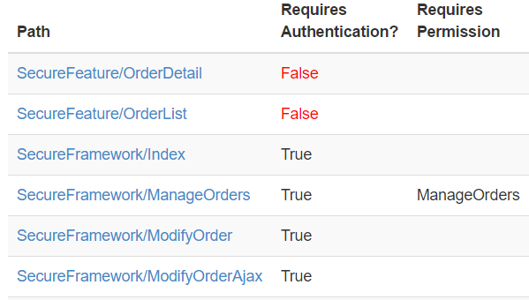
Authorization auditing

Slide 69
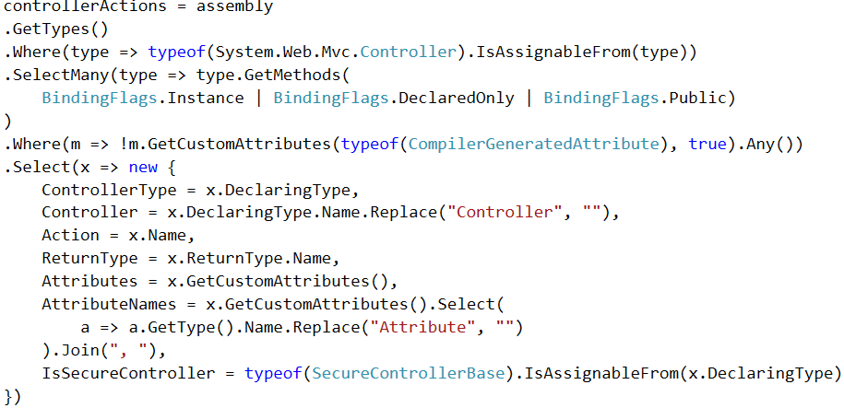
Authorization auditing

Slide 70
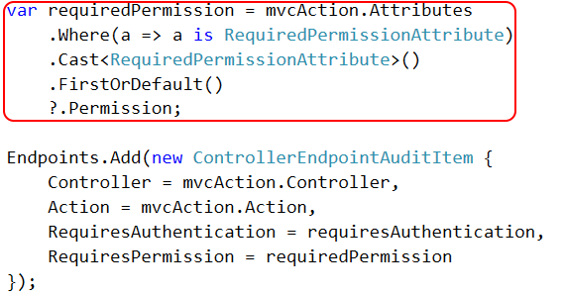
Authorization auditing

Slide 71
Authorization auditing

Slide 72

http://approvaltests.com

Slide 73
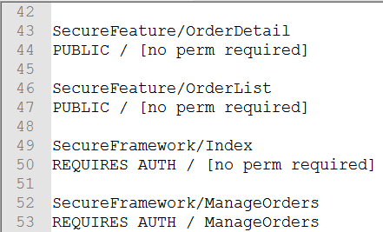
Approval Tests – Step 1

Slide 74
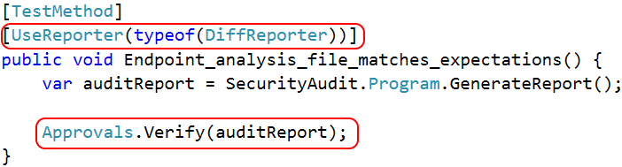
Approval Tests – Step 2

Slide 75
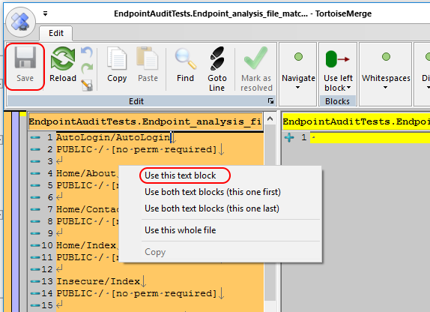
Approval Tests – Step 3

Slide 76
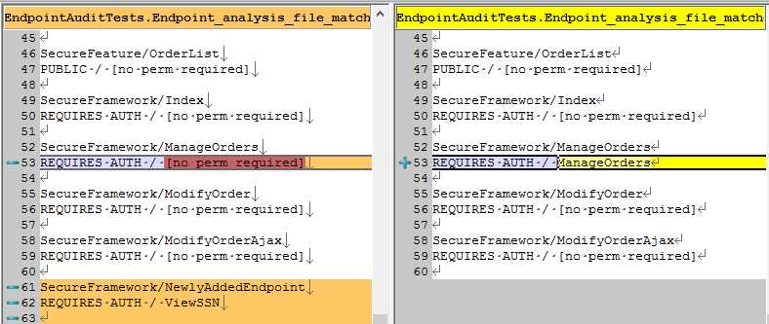
Approval Tests – Step 4

Slide 77
What makes auditing easier?
Using [Attributes] to decorate classes/methods
Inheriting a base class
Implementing an interface

Slide 78
Recap – 55 minutes of knowledge, 1 slide
Cross cutting concerns ➔ framework code
"Secure by default" is the holy grail
Declarative > imperative
Automated audits > exhaustive testing
bit.ly/2i0J91d
github.com/spetryjohnson | www.petry-johnson.com
@spetryjohnson

